Slide 1

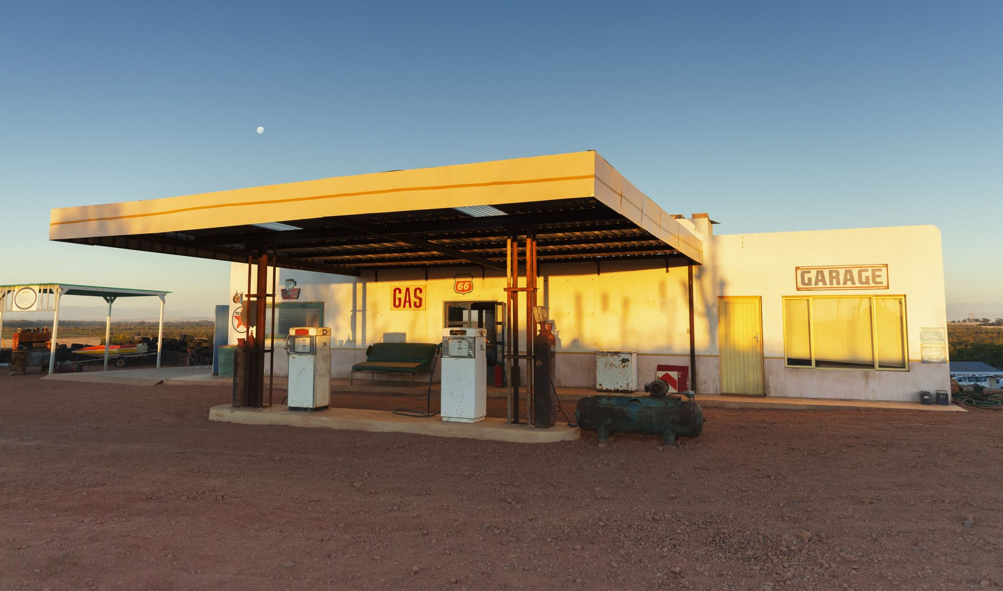
Capstone 2: Fuel Economy and Costs
Presented by: Samuel Wilson

Slide 2
Project Goal
Understand what impacts fuel economy and annual fuel costs
Manufacturer
Vehicle Type
Transmission Type
Fuel Type

Slide 3
Hypotheses
Null Hypothesis 1 (H0):
Transmission type had no impact on average City MPG
Alternate Hypothesis 1 (Ha):
Transmission type does have an effect on average City MPG
---------------------------------------------------------
Null Hypothesis 2 (H0):
Transmission type had no impact on average Highway MPG
Alternate Hypothesis 2 (Ha):
Transmission type does have an effect on average Highway MPG
---------------------------------------------------------
Null Hypothesis 2 (H0):
Transmission type had no impact on average annual fuel costs
Alternate Hypothesis 2 (Ha):
Transmission type does have an effect on average annual fuel costs

Slide 4
Process
Collect data on transmission types, vehicle manufacturers, vehicle types, fuel types, fuel economy, and annual fuel costs over time
Conduct statistical analyses to see if there is any statistically significant difference between manual or automatic transmission types when comparing the data of city and highway fuel economy and fuel costs
Compare the average city and highway fuel economy between the different manufacturers, vehicle types, and fuel types

Slide 5
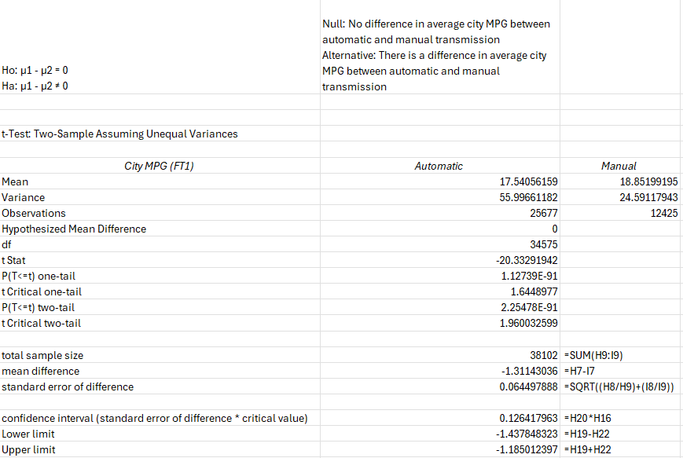
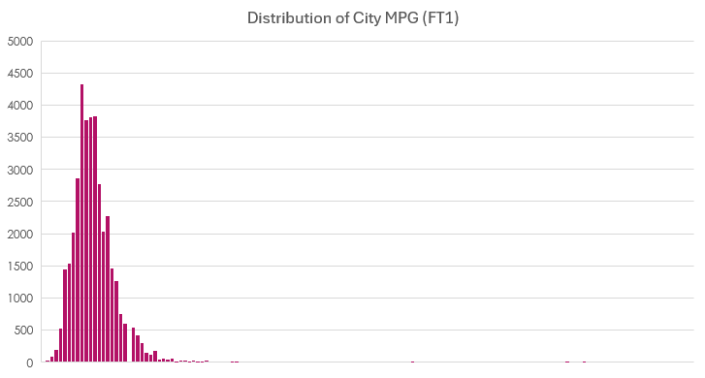
Analysis of City Fuel Economy
(The null hypothesis is rejected)
Conclusion:
There is a significant difference between automatic and manual transmissions when it comes to city fuel economy

Slide 6
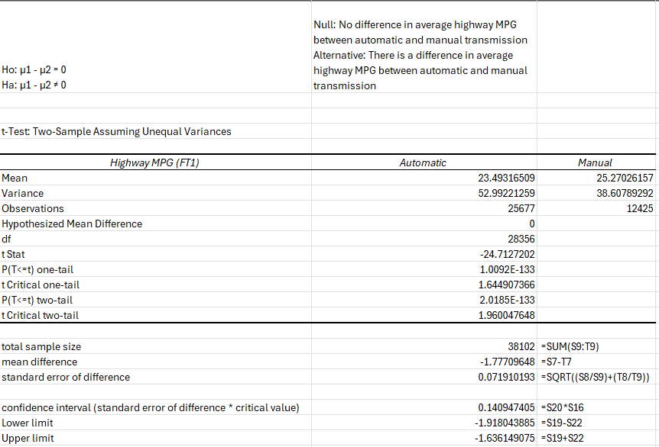
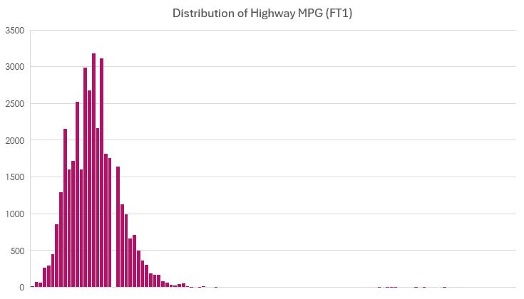
Analysis of Highway Fuel Economy
(The null hypothesis is rejected)
Conclusion:
There is a significant difference between automatic and manual transmissions when it comes to highway fuel economy

Slide 7
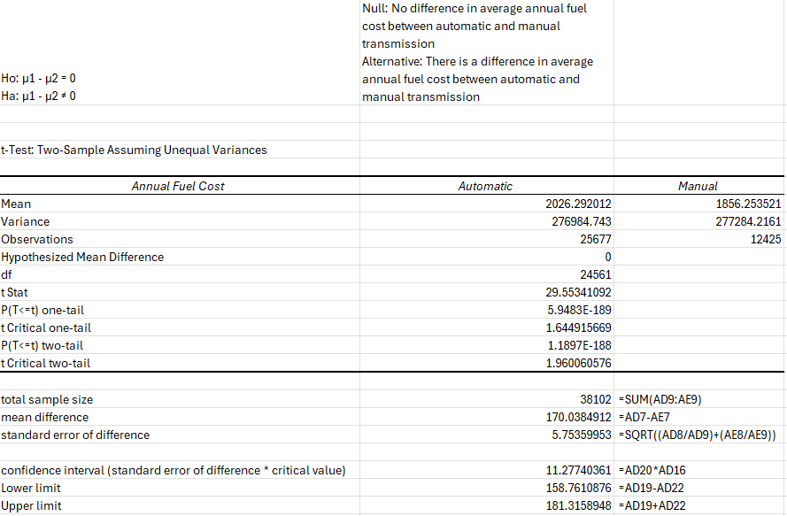
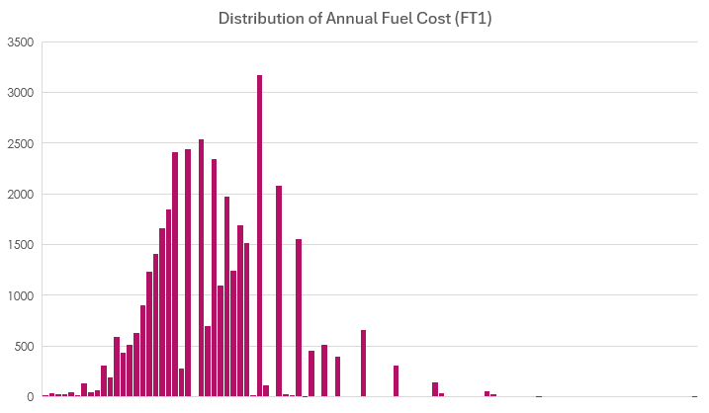
Analysis of Annual Fuel Costs
(The null hypothesis is rejected)
Conclusion:
There is a significant difference between automatic and manual transmissions when it comes to annual fuel costs

Slide 8
Average Fuel Economy by Manufacturer

Slide 9
Average Annual Fuel Costs by Manufacturer

Slide 10
Average Fuel Economy by Vehicle Type

Slide 11
Average Annual Fuel Costs by Vehicle Type

Slide 12
Average Fuel Economy by Fuel Type

Slide 13
Average Annual Fuel Costs by Fuel Type

Slide 14
Final Message and Recommendations
The statistical analyses showed that the transmission type
Does have a significant impact on city and highway fuel economy
Does have a significant impact on annual fuel costs
Vehicle Manufacturer, Vehicle Type, and Fuel Type all also have differences in averages for fuel economy and fuel costs.
Automatic transmissions have the larger variance, caused by electric vehicles having a higher MPG and lower annual fuel costs.
Recommendation:
When offering advice around that lead to better fuel economy and lower annual fuel costs, recommend electric vehicles, if possible, with diesel vehicles as the next fuel efficient and cost-effective option.

